Slide 1


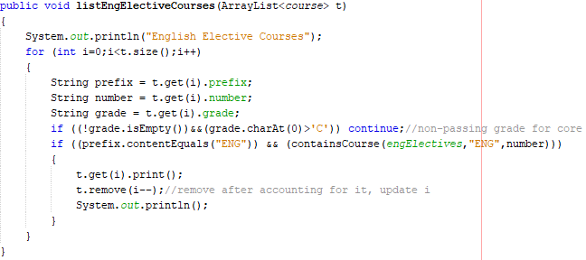
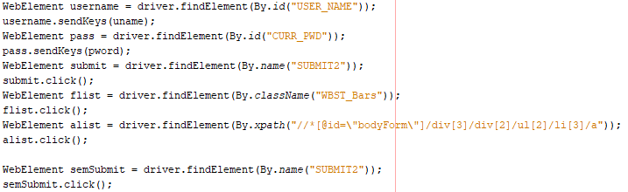
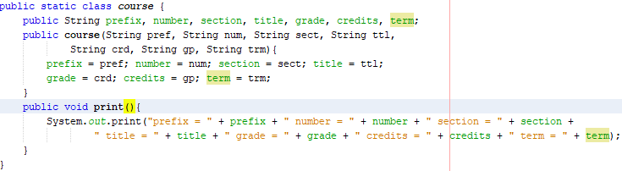
Department of Mathematics and Computer Science
Barry University
11300 NE 2nd Ave.
Miami Shores, FL 33161
Phone: (305) 899-3286
An Automated Advisor Assistant
Kyle Lothian, Ricardo Gomez, and Dr. James Haralambides
(Department of Mathematics and Computer Science, Barry University, Miami Shores, FL)
Barry University, Miami, FL
Abstract
Implementation of the Automation Process
Program's Educational Requirements
The goal of the project is to build upon an Android app that creates an unofficial degree audit for a student. The app is intended to automatically download a student’s transcript once they login to web advisor, and display all relevant results to the user on the front-end. The back-end side will be able to read the student’s unaltered transcript, extrapolate all relevant results such as prefixes of classes taken, semester taken, grade, etc., and insert them into a database. The user’s information is cross-referenced to an official degree curriculum so that the user can see what courses the student has not taken yet, needs to retake, or can take in place of another class. Ultimately, we want to be able to algorithmically provide suggestions to the student for future courses they can register for or recommend courses that can be substituted for by others. Our hope for this application is to streamline the class registration process for both the student and academic advisor in order to ensure that all academic requirements, as outlined by the program(s) requirements of the student’s discipline(s), are met in a timely manner for students to acquire their degree according to plan. At its current build, the project solely functions in accordance to the Computer Science Major program as well as a required Minor in Mathematics. However, the ultimate goal for this project is to provide unofficial degree audit reports and recommendations to students, as well as their advisors, regardless of their field of study.
Contrary to what many people may believe, the most popular mobile operating system in the world is Android. As of October 2017, over 65% of all smart phones run some version of the Android OS. Apple’s iOS, on the other hand, is used in a little over 35% of smart phones globally [1]. Like almost all other operating systems, the Android OS has numerous, different software versions, like 5.0 Lollipop, 6.0 Marshmallow, 7.0 Nougat, 8.0 Oreo, and the yet to be publicly released (or properly named) 9.0 Android P. [2] Thankfully, developing Android apps is never before been easier because of the existence of the integrated developer environment called Android Studio. This powerful IDE is built on top of another IDE that is based on the programming language Java. No need to learn an entirely new language.
The first screen a student will be faced with is a log-in screen where s/he must enter their Barry credentials. Once the student has successfully logged in, our application through Selenium and a web driver of Google Chrome called ChromeDriver, will programmatically navigate to the transcript by clicking on the necessary links to access this page. Normally, after logging in, a student would click on a link labeled “My unofficial transcript” under the section “Academic profile,” select the option named “UG Undergraduate” from a drop-down list, and finally click submit. Initially, we thought this process could be avoided by redirecting the student to a URL that is constructed dynamically with HTTP headers that correspond to their log-in information. However, the URL to the transcript page always contained a header named “TOKENIDX” that would be generated randomly. Therefore, accessing the webpage of the transcript through a URL was not an option.
The solution to this problem involved the utilization of Chromedriver. Through this driver, we were able to find a particular HTML element, such as a link or button, store a reference to this element in a variable of type WebElement, and click on it and allow the on click listener built into the website to do the rest. There are several ways in which we were able to wire a HTML element to a variable of ours. All of which involved looking at the source code of the webpage. From there, we can reference an element by their name, id, xpath, or even tag name. An example from our code can be seen in the photo below.
Once the automation process of extracting all of the student’s transcript is complete, the front-end will display all classes within the table in different sub-categories. Some of the categories include CS core classes, CS electives, math minor, theology and philosophy and other general education requirements. In addition, a section labeled “Remaining Classes” would be shown to inform the students of any classes s/he needs to enroll in to graduate with a degree.
Depending on a student’s major(s) and/or minor(s), a series of course must be taken in order to fulfill the academic requirements specified by their current program(s). In a perfect world, the unofficial transcript page would contain a section that lists all the classes left for a student to enroll in to graduate in a timely manner. However, such is not the case. To find these missing classes, students typically must meet with their advisor(s) and cross out all the courses the student has taken that are listed on the program’s master list. Such a process takes time. Due to this inconvenient process, we have continued and improved upon the work of previous colleagues of ours with this application in order to streamline this whole procedure. The data structure used to store all the student’s transcript information is implemented an ArrayList. This ArrayList is of type “course,” a Java class we created meant to store the prefix, number, section, title, grade, credits, and term for each class from the transcript table. There are also an ArrayList that relates to the CS core classes, another for CS electives, a third for the math minor, a fourth for the Theology/Philosophy requirements, and so on. These ArrayLists are occupied by courses in accordance of the program’s master list for a particular field of study. Once we have stored all the information we need, we iterate through the transcript ArrayList and look for classes with passing grades that satisfy the education requirements for a specific field of study, i.e. English. Each field of study has its own method that lists all the classes in the transcript that relates to it. Below is a method we implemented that prints out classes in a student’s transcript that satisfies an English requirement.
Below is the implementation of our Java class “course”:
H₂O
Automating the Transcript Process
As of this moment, accessing the unofficial transcript of an undergraduate student must be done manually through WebAdvisor. WebAdvisor is a system that provides students with vital links and resources that can aid them in searching and registering for classes, contacting their advisor(s), applying for graduation, accessing their financial aid information, and viewing their current unofficial, undergraduate transcript. The information of a student’s transcript is organized in a tabular format with some columns titled “Course/Section and Title”, “Grade”, “Credits”, and “Term.” All the classes the student has taken, is currently taken, or were transferred over are represented by the table’s rows.
Our Android application, with the help of the web automation tool Selenium, will programmatically access a student’s unofficial transcript; extrapolate all the classes identified by the rows; store these classes in a data structure in terms of the their prefix, section, number, title, grade, credits, and the term in which they were taken; and display all this information in an organized manner on the front-end of the device. Of course, the student’s credentials are required to access their transcript; however, the process of reaching the transcript page is now automated. No longer does the student need to take several steps to reach this information.
References
[1] https://mybroadband.co.za/news/software/232485-the-most-popular-operating-systems-for-smartphones-and-pcs.html
[2] https://en.wikipedia.org/wiki/Android_version_history

